Slide 1
Problem Statement
AtliQ Hardware is struggling in Latin America, relying on surveys and intuition for decisions. Previously, they used MS Excel for analysis due to limited data, but with growth, they now have ample data. Therefore, they hired a Data Analyst to make informed decisions using this data.
Management’s Dashboard Requirements:
Finance View:
Supply Chain:
1
3
Profit and loss statements by product, market, and customer.
Reliability and accuracy metrics for supply chain performance..
2
Marketing View:
Executive View:
4
Sales data by product.
Key insights for executives.

Slide 2
Business Insights 360 – Power BI Project By Codebasics.
The Business Insights project is part of the Codebasics Data Analytics Bootcamp. It’s a complete Data Analysis and Power BI project based on a fictional company, AtliQ Hardware.
AtliQ Hardware manufactures and sells products like PCs, mice, and printers to companies worldwide. Their customers include Croma, Amazon, Neptune, Staples, and Walmart, and they serve both physical stores and e-commerce platforms.

Slide 3
Project Execution
Below are the steps involved in project execution
Load the data into a MySQL Database and connect it to Power BI.
Transform data, e.g., create a dynamic Last Sales Month Reference table.
Create calculated columns using over 40 DAX formulas, verifying them with MySQL or Excel.
1
4
7
Review and delete default database relationships created by Power BI; create required dimension tables in Power Query.
Create calculated columns in Power Query (e.g., fiscal year) and merge tables.
Optimize the report to reduce file size for easier sharing and access before designing and building dashboards.
2
5
8
Validate data using tables in Power BI and match values with provided data.
Perform data modeling using a Star Schema to connect dimension tables with fact tables.
3
6

Slide 4
Building The Dashboard
I created 5 different report views for various stakeholders. Here’s an overview:
Home Page
Marketing View:
01
The first page includes navigation to all views and a summary of each for easy access.
04
Contains Gross Margin %, Net Profit %, Operational Expenses, and Cost of Goods Sold. Helps in deciding marketing budgets and identifying potential customers and markets.
Finance View:
Supply Chain View:
02
05
Provides data on demand forecasting and inventory management. Shows historical forecast accuracy and highlights issues, like a drop in Accessories segment performance.
Shows P&L statements, top/bottom performing products and customers, product segment performance by region, and Year on Year P&L comparison. A button displays Net Sales performance vs. Last Year and vs. Target.
There are people who have a significant number.
Sales View:
Executive View:
03
06
A consolidated report with key metrics like Net Sales, Return on Capital %, Gross Margin %, Net Profit %, Forecast Accuracy %, Market Share, top-selling products, and top customers. Designed for senior stakeholders to get a quick overview without delving into details.
For the sales team to analyze product and customer performance in each region with similar filters as the Finance View.
There are people who have a significant number.

Slide 5
Tools Used in Project:
Learnings from Project:
Power-BI Skills
MS Excel
MySQL
Data Modelling
Power-BI
Dashboard Creation & Designing
Project Charter
Power-BI Service
Stakeholder Mapping
Analysing P&L Statements

Slide 6
Focus: Analyzing business transactions such as Profit %, Gross Margin %, Forecast %, and sales comparisons using DAX formulas..
DAX Formulas: Key measures for building the report.
1
6
Understanding P&L statements..
1
6
Data Modeling: Structuring data relationships.
Project work:
Comparing product, category, market, and customer performance.
Learning Outcomes:
Table Creation: Building tables for data representation.
2
The first page includes navigation to all views and a summary of each for easy access.
7
Power BI Features Learned & Used:
Providing comprehensive financial stats and performance metrics on dashboards..
Creating Tool Tips: Adding helpful information to visuals.
3
8
Different Views: Tailoring reports for different departments in a single report..
Provides data on demand forecasting and inventory management. Shows historical forecast accuracy and highlights issues, like a drop in Accessories segment performance.
4
9
Creating Switch using Bookmark: Allowing dynamic view changes.
5
10
Creating Dynamic Titles: Updating titles based on data changes.
5
10
Conditional Formatting: Handling blank results after filtering.
5
10
Dynamic Last Refresh Date: Showing the latest data update.

Slide 7
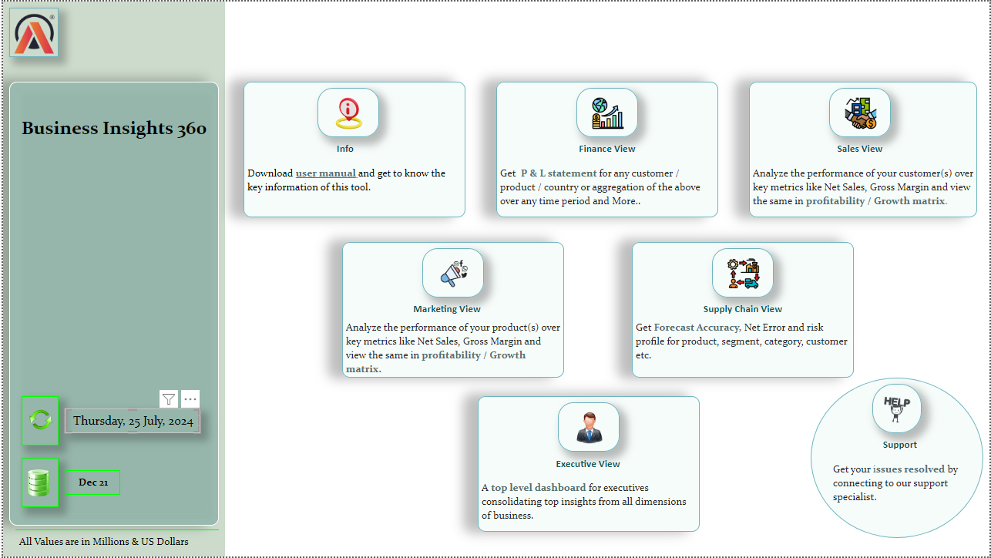

Slide 8
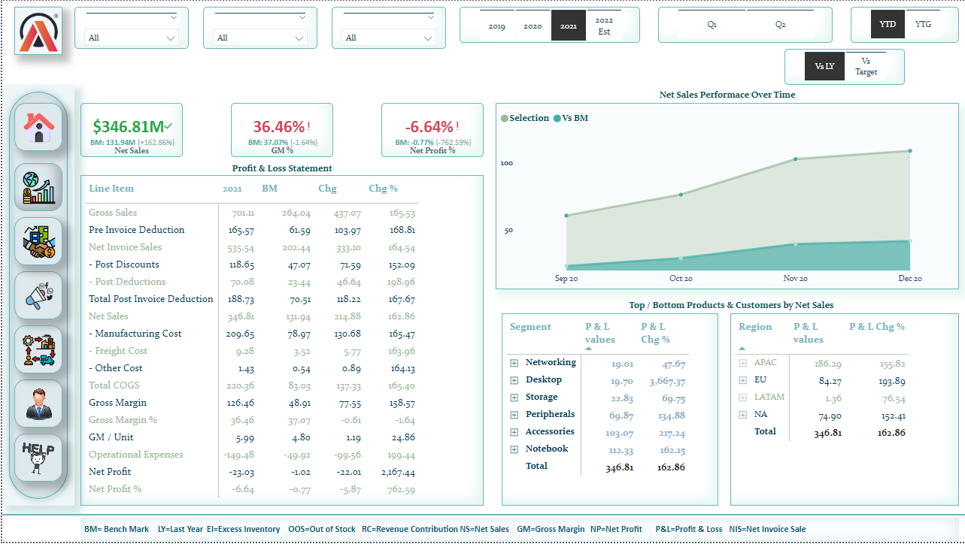

Slide 9
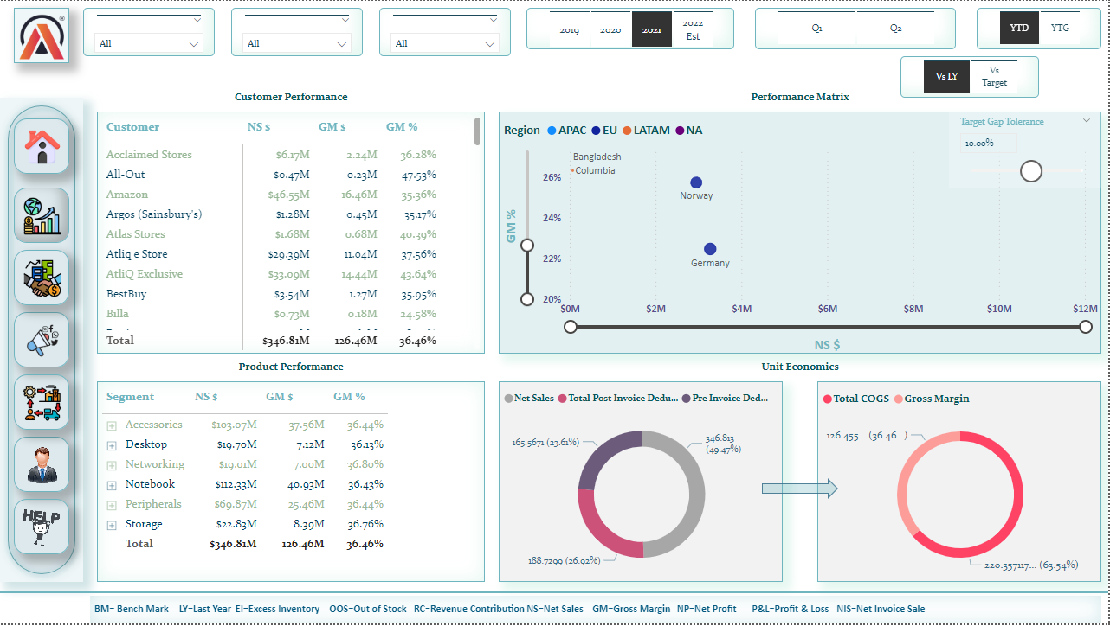

Slide 10
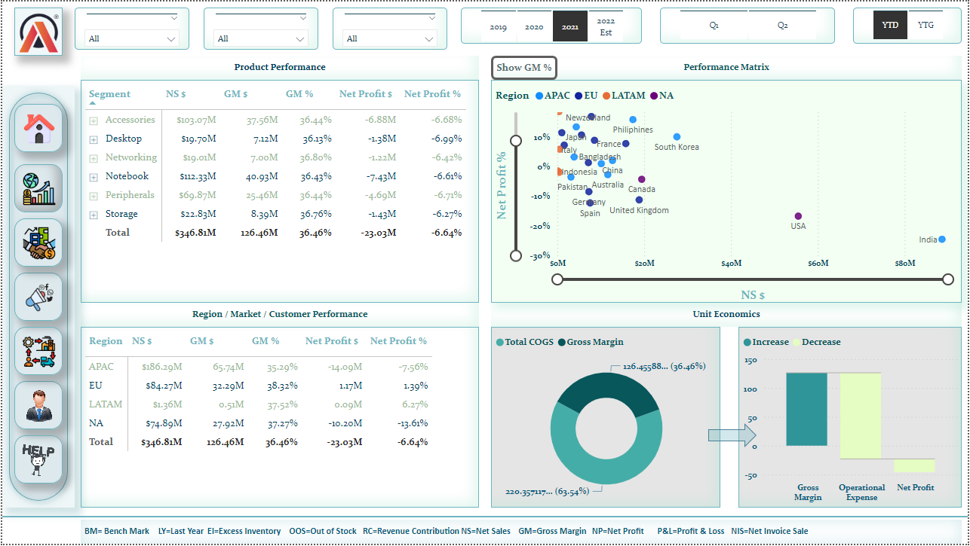

Slide 11
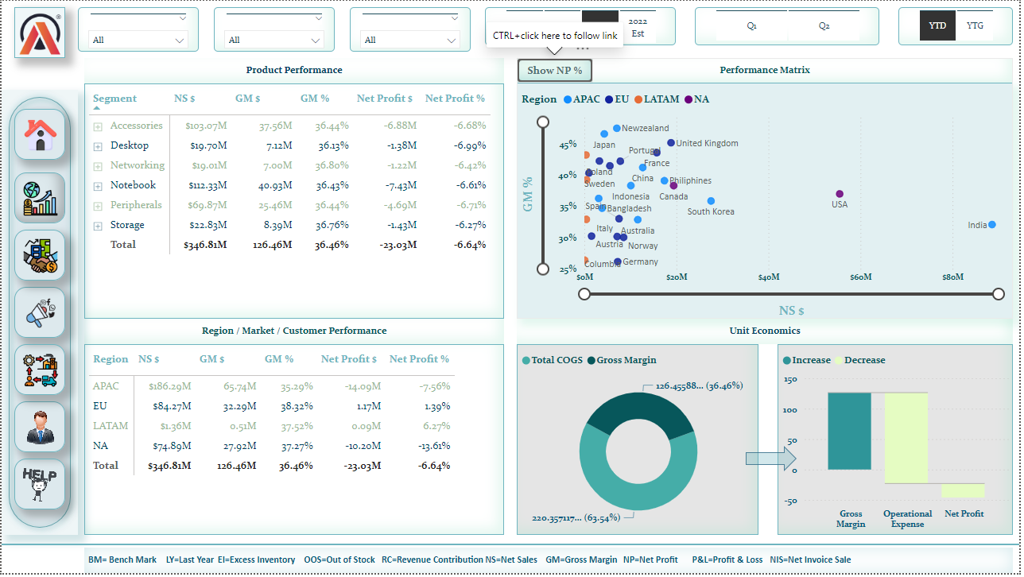

Slide 12
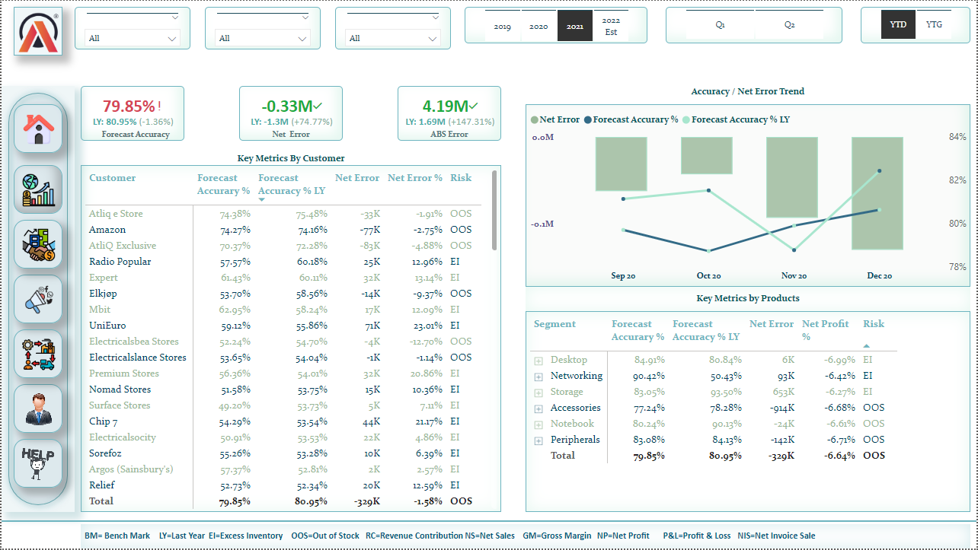

Slide 13
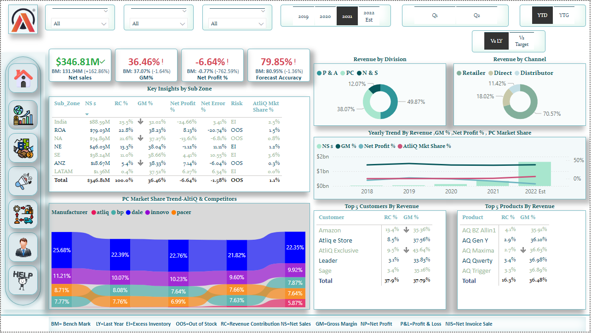

Slide 14
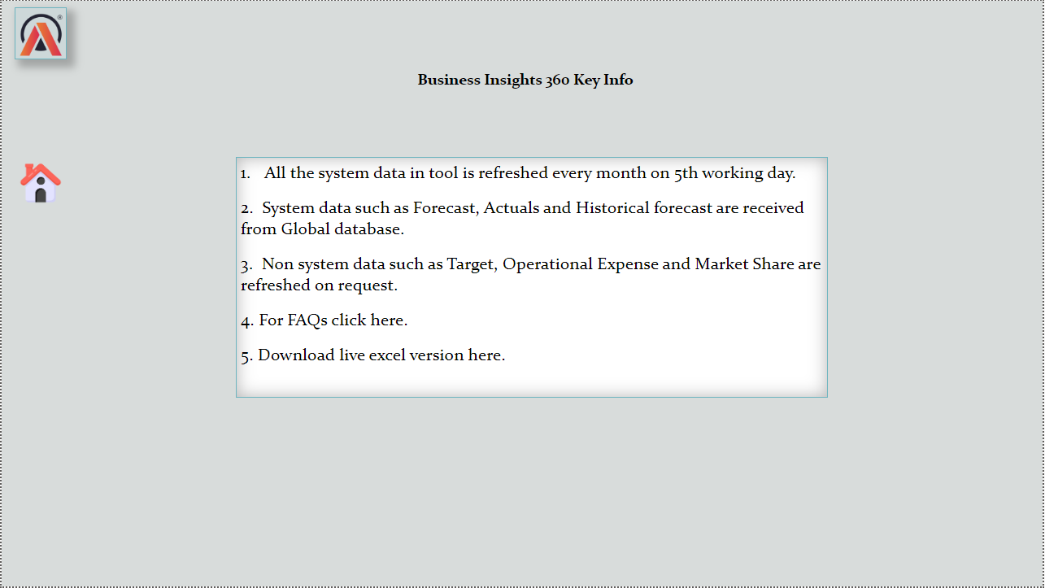

Slide 15


1
Get an Issue resolved
2
Provide Feedback
5
New to Power-BI?
3
Check out the Contingency Plan
4
Any New Request

